Slide 1

Machine Learning-Based Real-Time Conveyor Inspection and Performance Improvement for Steel Industries
INDUSTRY TRAINING
18ECSI493
Submitted By
Shreyas Joshi 01FE20BCS145
Under the guidance of
Mrs. Pratibha R Malagatti

Slide 2
Introduction
Video analytics is a rapidly evolving field that leverages artificial intelligence and machine learning to extract valuable insights from video data.
By harnessing the power of machine learning, artificial intelligence, image processing, and video data processing, technologies like OpenCV and YOLO can provide instantaneous analysis directly on the factory floor.
I had the opportunity to delve deep into these tools and technologies, gaining hands-on experience in their implementation. I explored the intricacies of machine learning and AI, understanding how these technologies are leveraged to analyze video data and extract meaningful insights.
I also experimented with different object detection models, gaining valuable insights into their strengths and limitations.
KLE Technological University

Slide 3
Introduction to AI/ML
At its core, AI simulates human intelligence processes using machines, enabling them to learn from data, adapt to new inputs, and perform tasks autonomously. | Machine Learning, a subset of AI, focuses on developing algorithms that allow computers to learn from and make predictions or decisions based on data.
Artificial Intelligence
Machine learning
KLE Technological University

Slide 4
Image Detection
Image detection is a fundamental task in computer vision that involves identifying and lo cating objects within an image. It is crucial for various applications, including autonomous driving, surveillance.
The process begins with preprocessing steps like resiz ing, normalization, and augmentation to enhance the quality and variability of the input data.
Convolutional Neural Networks (CNNs) have become the backbone of modern detection algorithms due to their ability to learn hierarchical features directly from raw pixel data.
State-of-the-art models like YOLO (You Only Look Once), SSD (Single Shot Multibox Detector), and Faster R-CNN have significantly improved detection accuracy and speed.
KLE Technological University

Slide 5
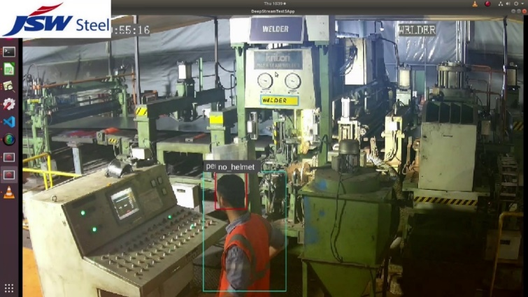
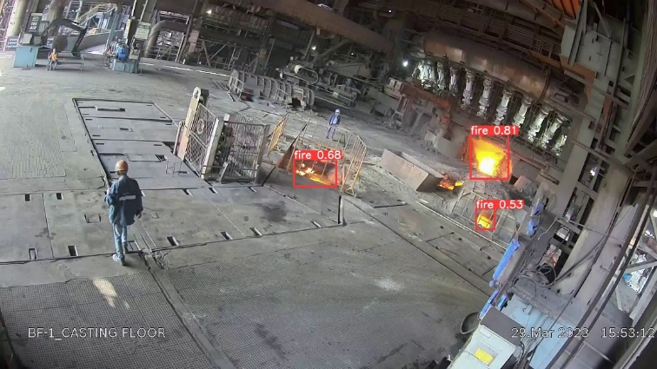
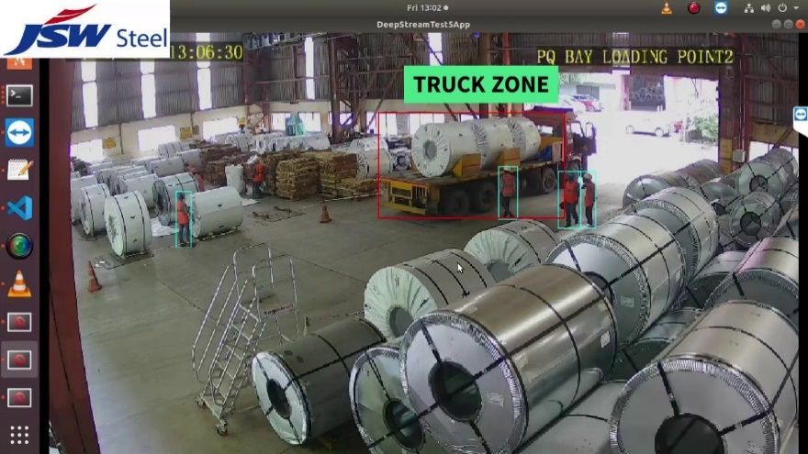
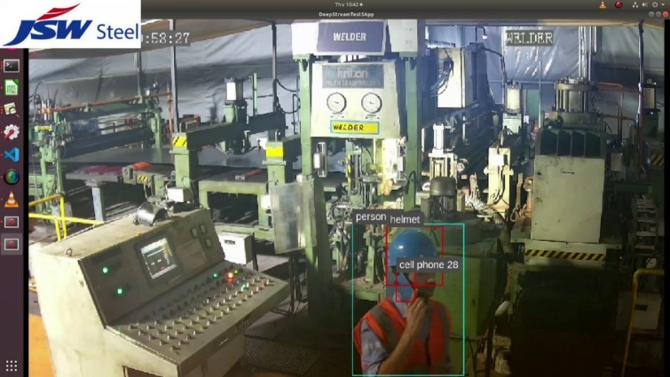
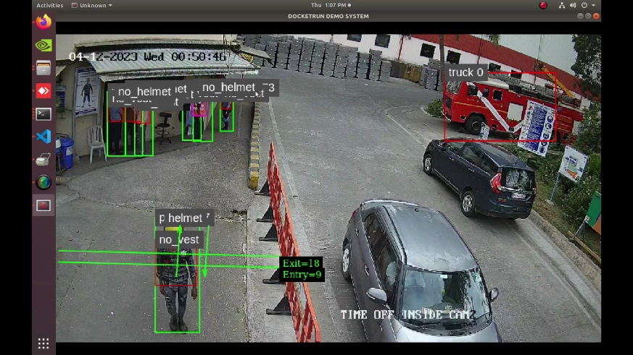
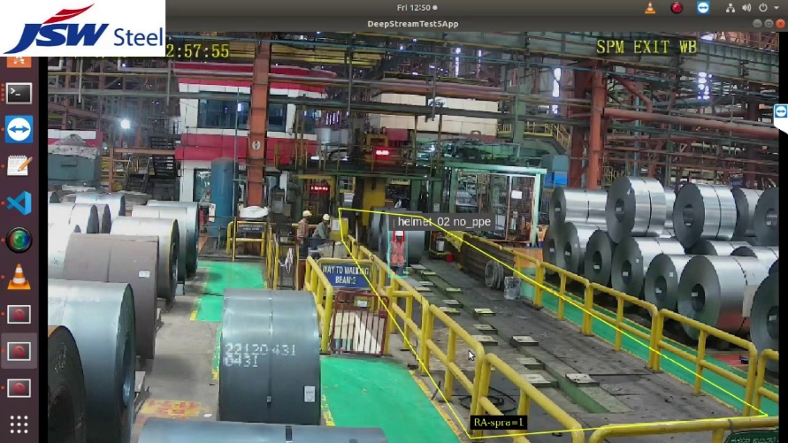
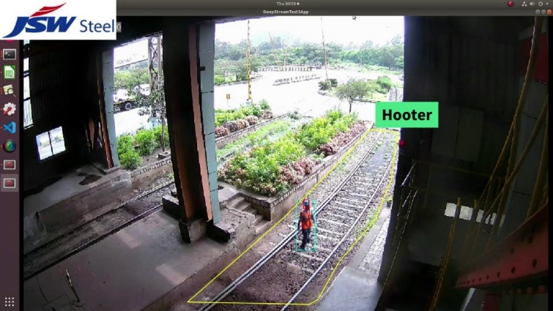
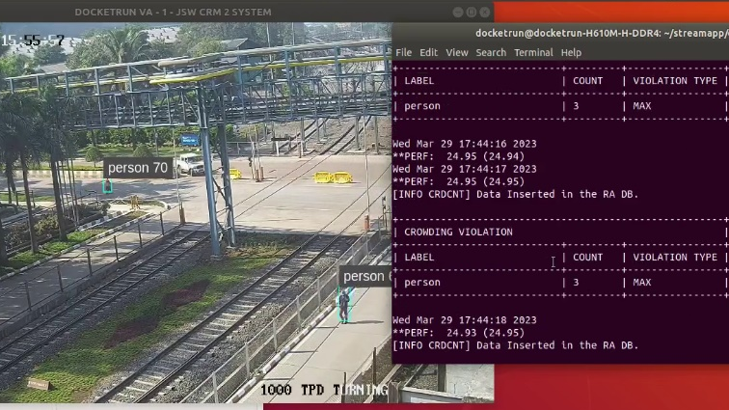
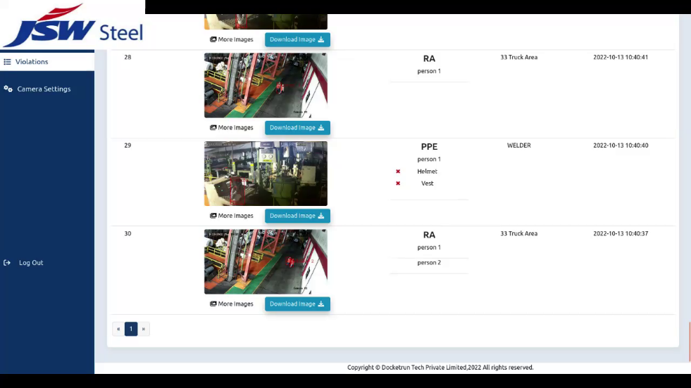
PERSONAL PROTECTIVE EQUIPMENT
FIRE DETECTION
TRUCK REVERSAL ALERT
MOBILE PHONE USAGE
TRAFFIC COUNTING
MAN-MACHINE INTERFACE
GEO-FENCING / RESTRICTED AREA
CROWDING
COMPLETE VIOLATION DASHBOARD
KLE Technological University

Slide 6
Objectives/Role of ML intern
My role involves developing an end-to-end system that ensures comprehensive and real-time monitoring and timely alerts. This includes designing and training machine learning models to accurately detect potential safety hazards or incidents from video footage or images using state-of-the-art object detection techniques.
Responsibilities:
Robust software development
Deployment
Maintenance of the software
conducting thorough testing to ensure reliability and accuracy
KLE Technological University

Slide 7
Tools and technologies
Data Collection and Preprocessing
Data cleaning and preprocessing
Image Processing
Image Transformation
Machine learning models
KLE Technological University

Slide 8
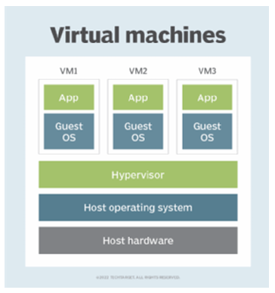
Oracle VirtualBox
Oracle VirtualBox is an open-source virtualization platform that allows users to run multiple operating systems simultaneously on a single physical machine.
KLE Technological University

Slide 9
LabelImg
LabelImg is an open-source graphical image annotation tool used for labeling images with bounding boxes for object detection tasks.
LabelImg offers an intuitive and user-friendly interface, making it easy for annotators to draw precise bounding boxes around objects of interest in images.
It supports various annotation formats, including Pascal VOC and YOLO, ensuring compatibility with different machine learning frameworks and pipelines.
LabelImg also provides useful features such as zooming, panning, and keyboard shortcuts for efficient annotation workflow. Additionally, it allows users to save and load annotation projects, facilitating collaboration and iterative labeling processes.
KLE Technological University

Slide 10
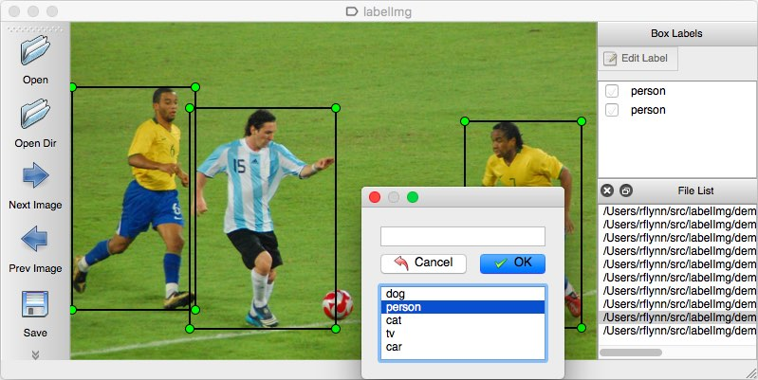

Slide 11
Tensor Flow
TensorFlow is an open-source machine learning framework developed by Google Brain. It is widely used for building, training, and deploying machine learning models.
TensorFlow offers a flexible and scalable platform for developing both research prototypes and production-ready applications.
TensorFlow provides high-level APIs like Keras for easy model development and low-level APIs for more fine-grained control and optimization.
Its extensive library of pre-built models and modules, known as TensorFlow Hub, allows developers to leverage pre-trained models for various tasks, speeding up development and reducing the need for large datasets.
KLE Technological University

Slide 12
Postgres
PostgreSQL is a powerful open-source relational database management system (RDBMS) known for its reliability, scalability, and extensive feature set. It offers robust support for ACID (Atomicity, Consistency, Isolation, Durability) transactions, ensuring data integrity and reliability.
Additionally, PostgreSQL provides comprehensive SQL support along with support for stored procedures, triggers, and user-defined functions, enabling developers to implement complex business logic within the database.
With its active community, frequent updates, and adherence to SQL standards, PostgreSQL is a popular choice when data integrity, performance, and scalability are paramount.
KLE Technological University

Slide 13
Tkinter
Tkinter is a built-in Python library for creating graphical user interfaces (GUIs) quickly and easily. It provides a simple and intuitive way to design and implement GUI applications,
Tkinter offers a variety of widgets, such as buttons, labels, entry fields, and text boxes, which can be easily customized to suit the specific requirements of the application. Its event-driven programming model al lows developers to define callbacks to handle user interactions, such as button clicks or key presses.
Tkinter’s seamless integration with Python’s object-oriented programming paradigm facilitates the creation of modular and maintainable code.
Tkinter applications can run on various platforms without requiring additional depen dencies.
KLE Technological University

Slide 14
OPenCV
OpenCV, short for Open Source Computer Vision Library, is a widely-used open-source library for computer vision and image processing tasks. It offers a vast array of functionalities, including image and video processing, object detection and tracking, feature extraction, and machine learning algorithms.
OpenCV provides a comprehensive set of tools and utilities for working with images and videos, enabling developers to perform complex operations such as edge detection, image filtering, and geometric transformations with ease.
Its Python interface, in particular, has made it highly accessible to developers, allowing them to leverage the power of OpenCV alongside the flexibility and simplicity of Python programming.
KLE Technological University

Slide 15
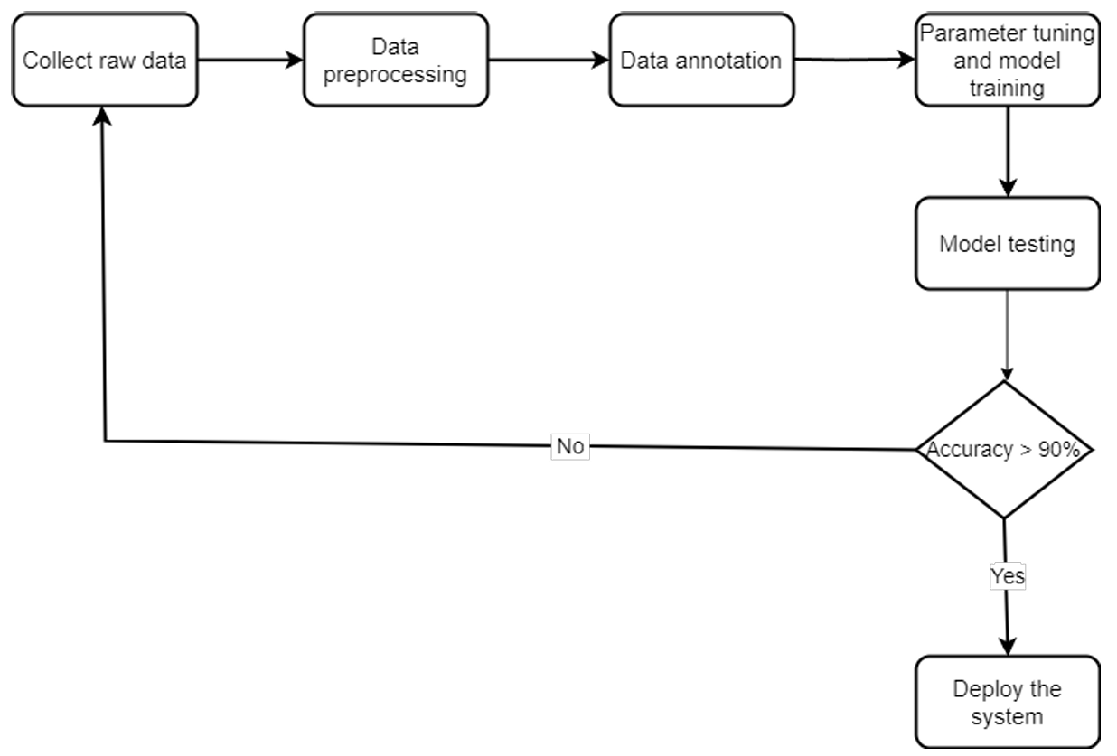
System Model
Figure 1: System model for conveyor detection
KLE Technological University

Slide 16
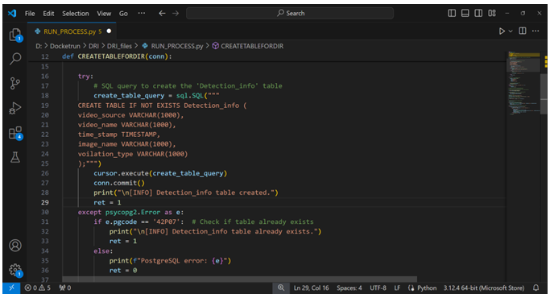
Implementation
KLE Technological University

Slide 17
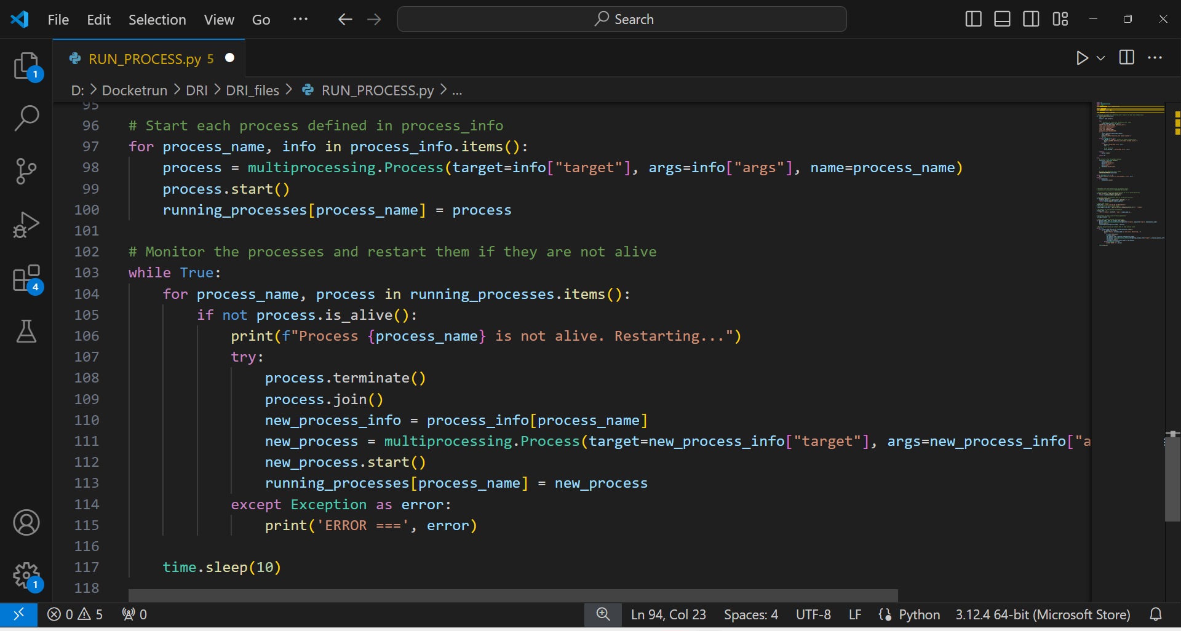
Implementation
KLE Technological University

Slide 18
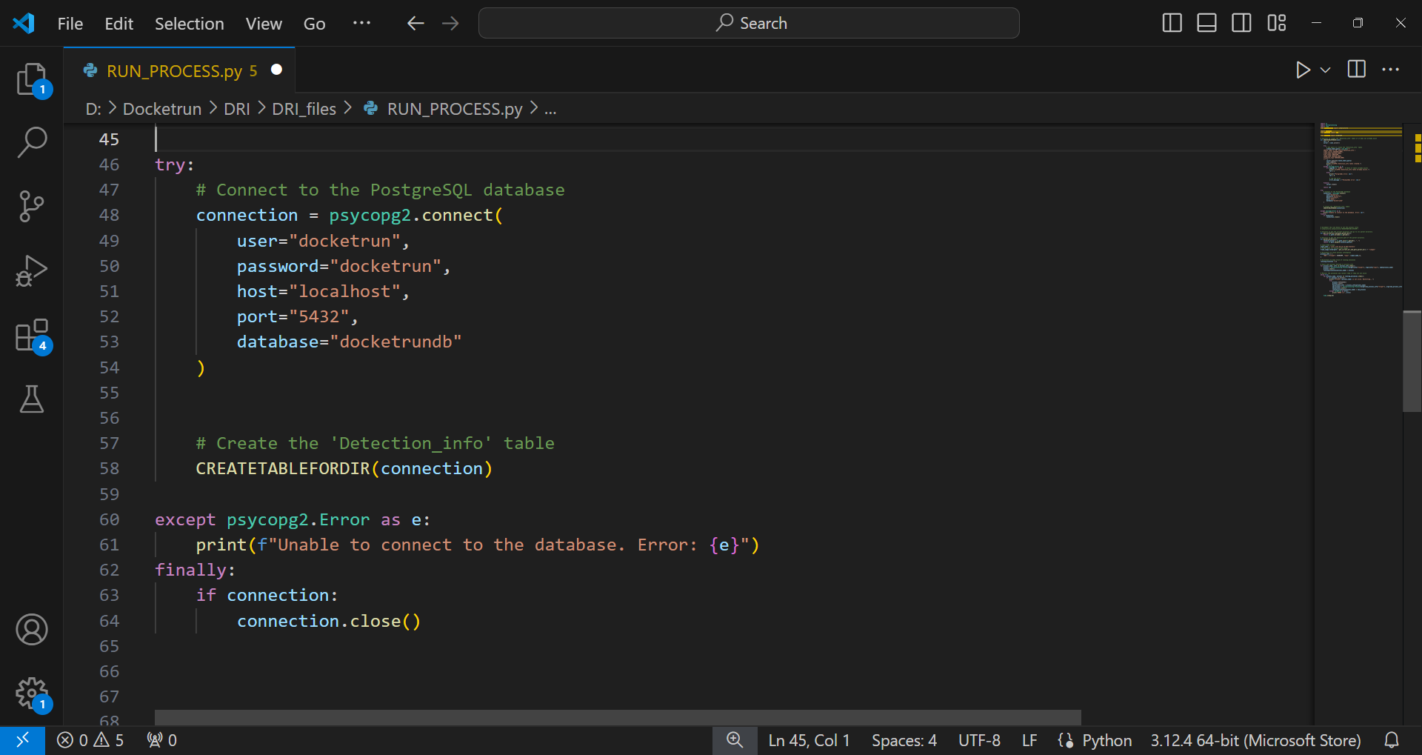
Implementation
KLE Technological University

Slide 19
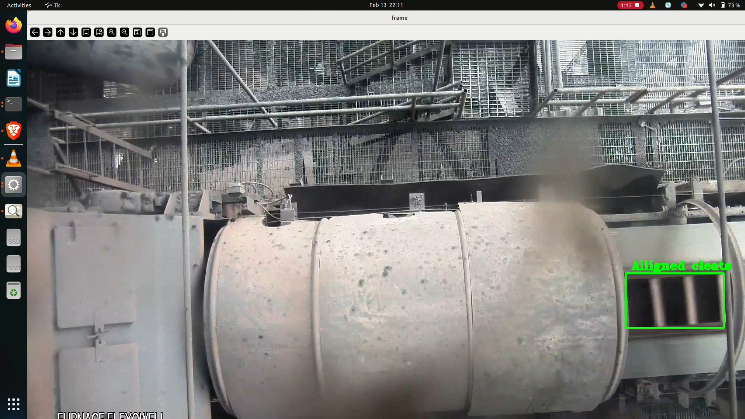
Results
KLE Technological University

Slide 20
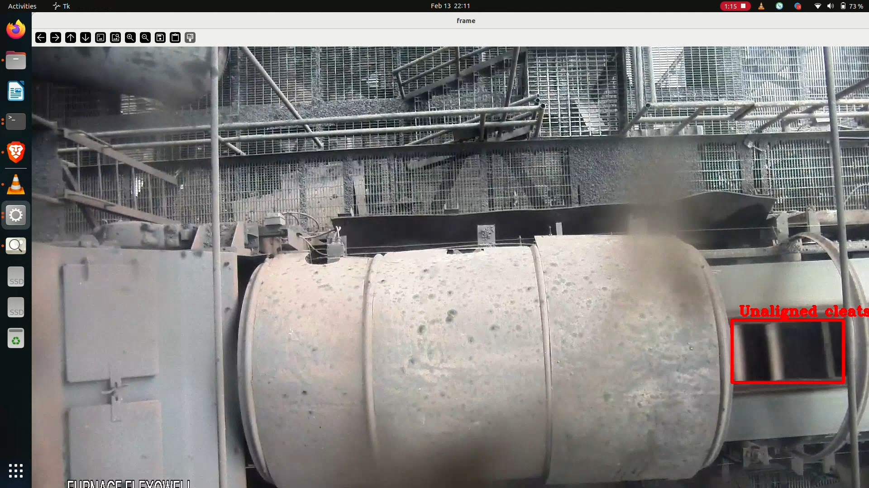
Results
KLE Technological University

Slide 21
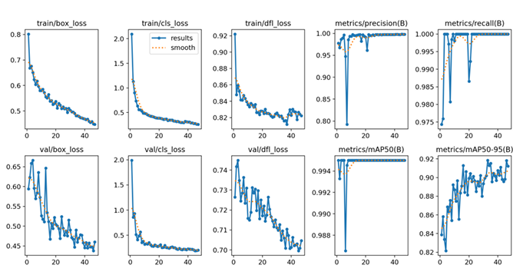
Results
KLE Technological University

Slide 22
THANK YOU!

